Slide 1
Clustering, Dimensionality Reduction and Instance Based Learning
Geoff Hulten

Slide 2
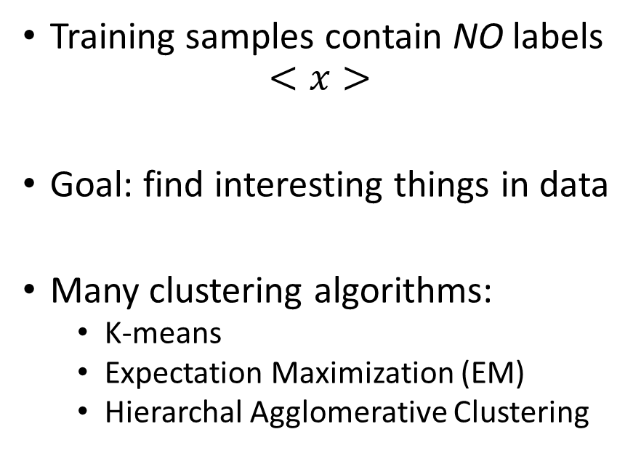
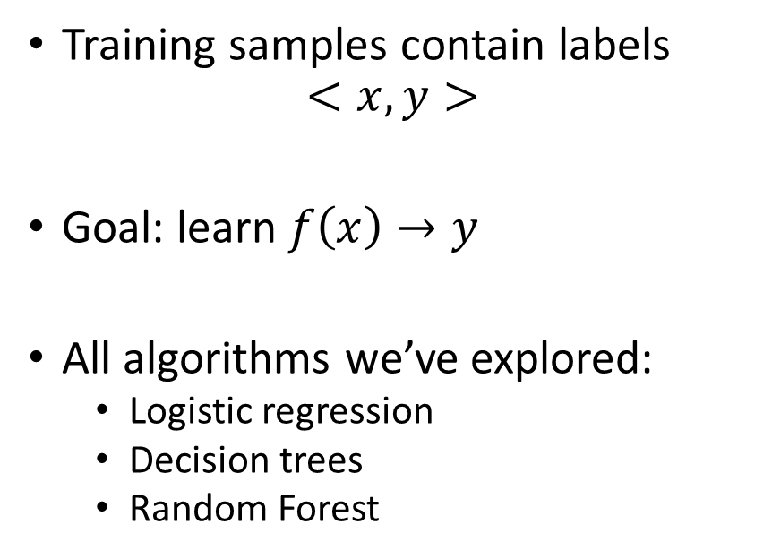
Supervised vs Unsupervised
Supervised
Unsupervised
Training samples contain labels
$$<x, y>$$
Goal: learn $f\left(x\right)→y$
All algorithms we’ve explored:
  Logistic regression
  Decision trees
  Random Forest
Training samples contain NO labels
$$<x>$$
Goal: find interesting things in data
Many clustering algorithms:
  K-means
  Expectation Maximization (EM)
  Hierarchal Agglomerative Clustering

Slide 3
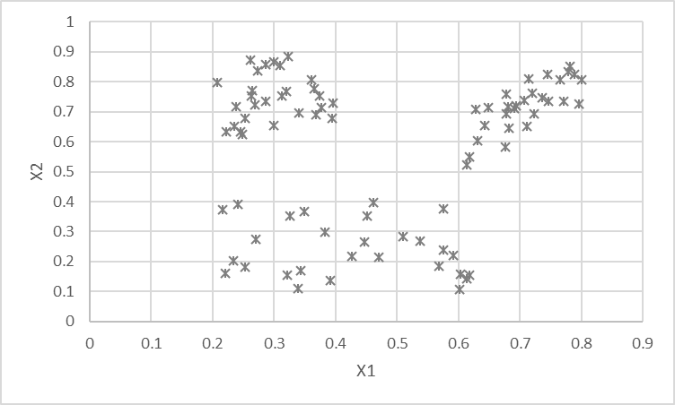
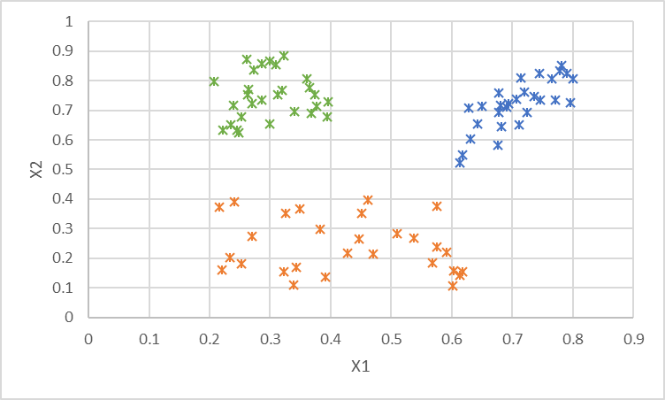
Example of Clustering
Why cluster?
  Recommendation engines
  Market segmentation
  Search aggregation
  Anomaly detection
  Exploring your data
    # of spammers
    Processes generating data
    Categories of mistakes

Slide 4
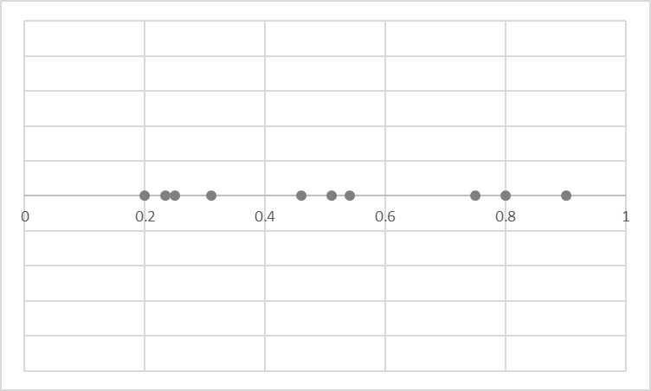
Some Important Types of Clustering
K-Means Cluster
Mixture of Gaussians
(Expectation Maximization)
Agglomerative Clustering
Cluster represented by a single point
Each point assigned to a cluster
Clusters placed to minimize avg distance between points and assigned clusters
Cluster represented by a gaussian
Each point has a probability of being generated by each cluster
Clusters placed to maximize likelihood of data
Hierarchical method
Each point is in a hierarchy of clusters
Each step combines nearest clusters into a larger cluster, cut where you want

Slide 5
K-Means Clustering – Model Structure
Structure – K cluster centroids
Loss – Average distance from sample to its assigned centroid
Optimization – Simple iterative process

Slide 6
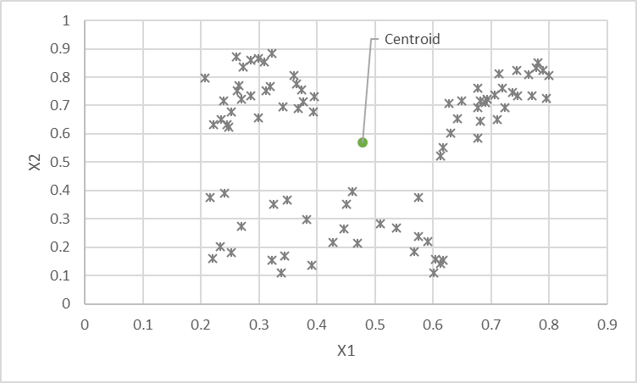
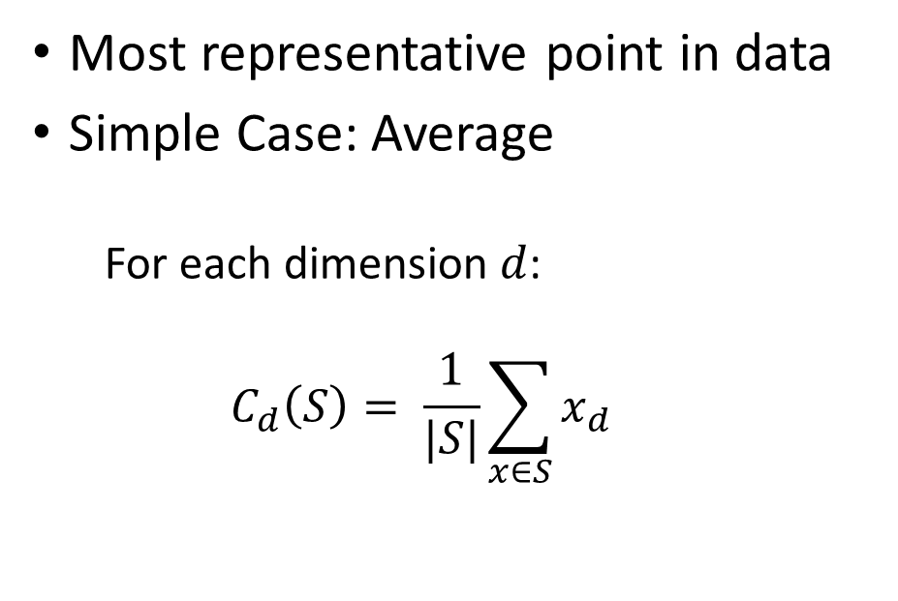
K-Means Clustering: The Centroid
Most representative point in data
Simple Case: Average
  For each dimension $d$:
  $$C_{d}\left(S\right)= \frac{1}{|S|}\sum_{x∈S}{x_{d}}$$

Slide 7







Distance Metrics (Loss) for K-Means
$$x$$
$$L^{n}\left(C_{x},x\right)= \sqrt[n]{\sum_{i=1}^{\#dim}{{|c_{i}− x_{i}|}^{n}}}$$
$$Loss\left(S, C\right)= \frac{1}{|S|}\sum_{x∈S}{L^{2}(C_{x}, x)}$$
$$d_{2}$$
$$C_{x}$$
$$d_{1}$$
L1 Norm ${|d}_{1}|+|d_{2}|$
L2 Norm = $\sqrt{d_{1}^{2}+ d_{2}^{2}}$

Slide 8
Optimizing K-Means
Initialize centroids to random data points
While loss is improving:
Assign each training sample to the nearest centroid
Reset each centroid location to the mean of assigned samples

Slide 9
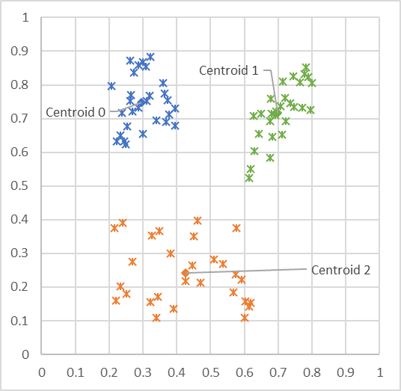
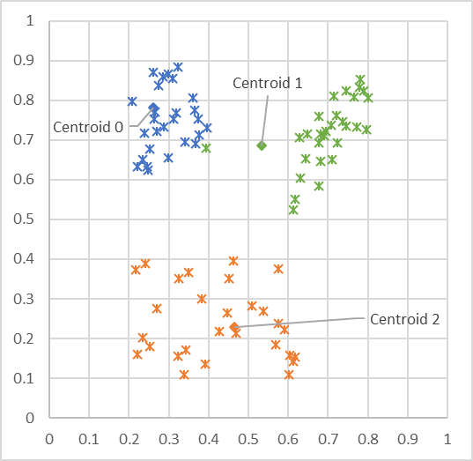
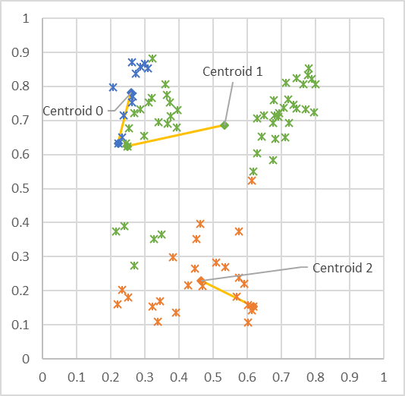
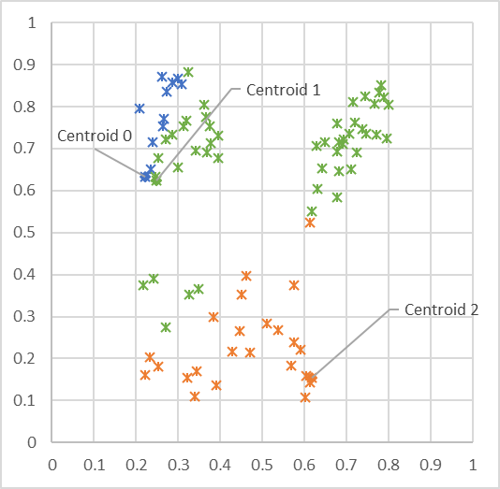
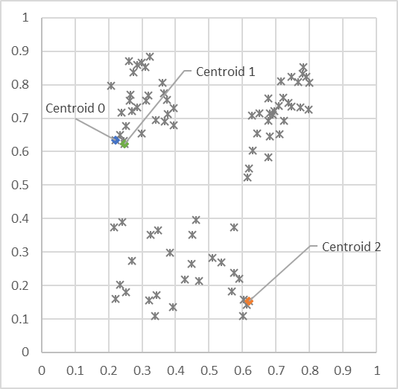
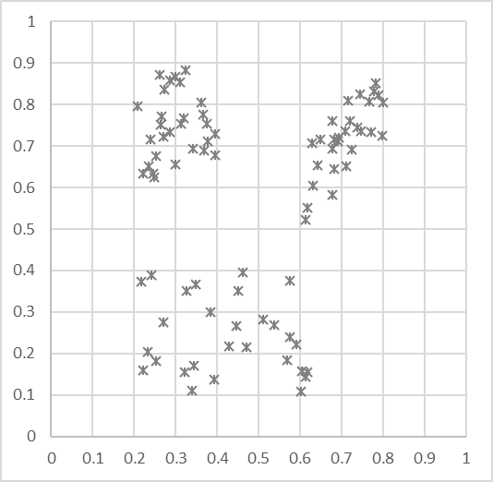

Visualizing K-Means
Unlabled Data
Initialize centroids to random data point locations
Each point assigned to nearest centroid
Update centroid locations to avg of assigned points
Each point assigned to nearest centroid
Update centroid locations to avg of assigned points
Each point assigned to nearest centroid
Converge!

Slide 10
Using K-Means
Pick a K based on your understanding of the domain
Run K-Means
Examine samples from each cluster
Adapt K based on what you find
  If single clusters contain different entities, increase K
  If entities spread across clusters, decrease K

Slide 11
Summary: Clustering
Use to find interesting things in your data when you don’t have labels
  Or when you want to explore your data or mistakes
Common types of clustering:
  K-means
  Expectation Maximization (EM)
  Agglomerative clustering
K means clustering is a simple algorithm that iteratively assigns points to clusters & updates centroid locations till convergence
Use clustering as an exploratory tool, vary number of clusters

Slide 12
Dimensionality Reduction
24x24 intensity array -> 576 features (dimensions)
Any individual dimension not very useful to the task
  intensity of a single pixel?
Can we find more meaningful dimensions?
  Represent the core of what is going on in the data
  Might not capture all the fine details
  More useful as input to machine learning algorithms

Slide 13
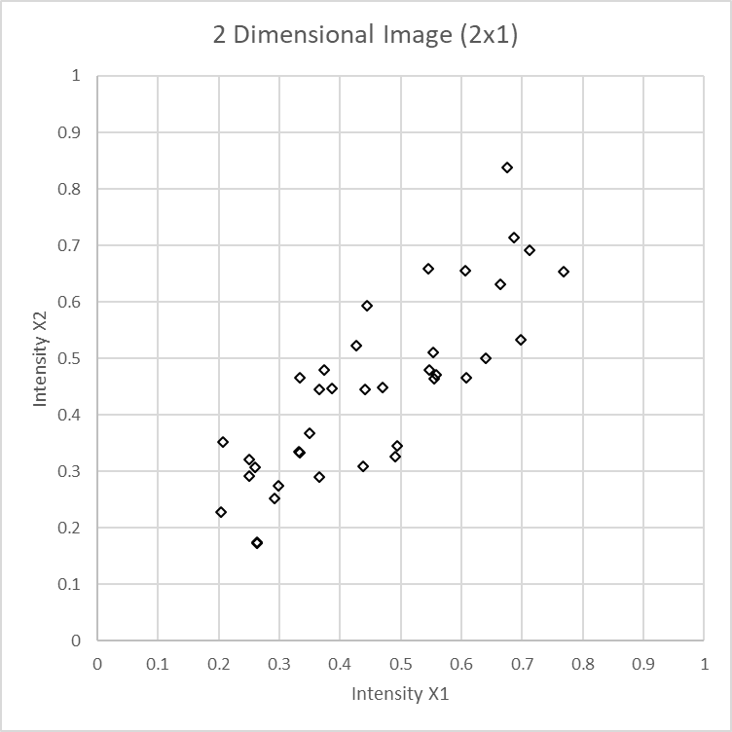
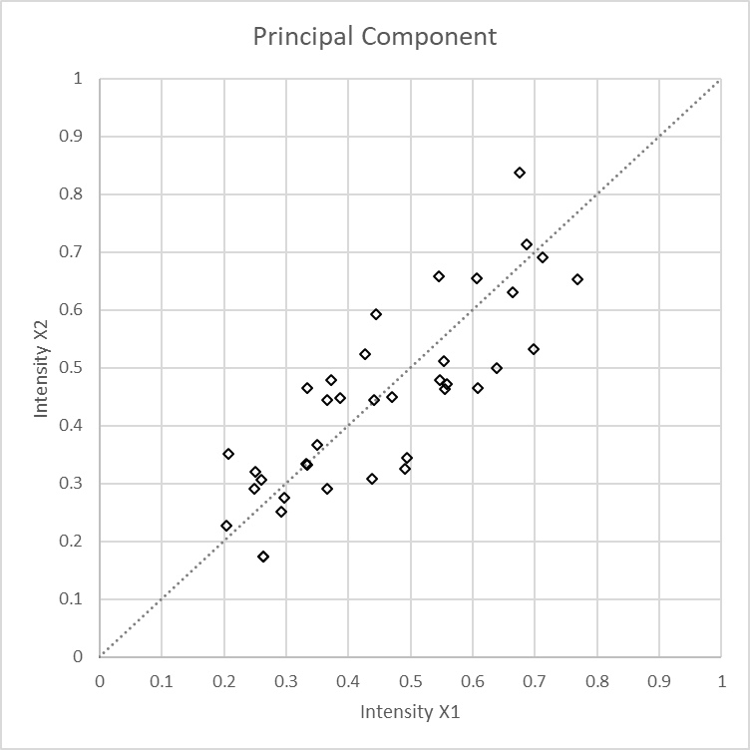
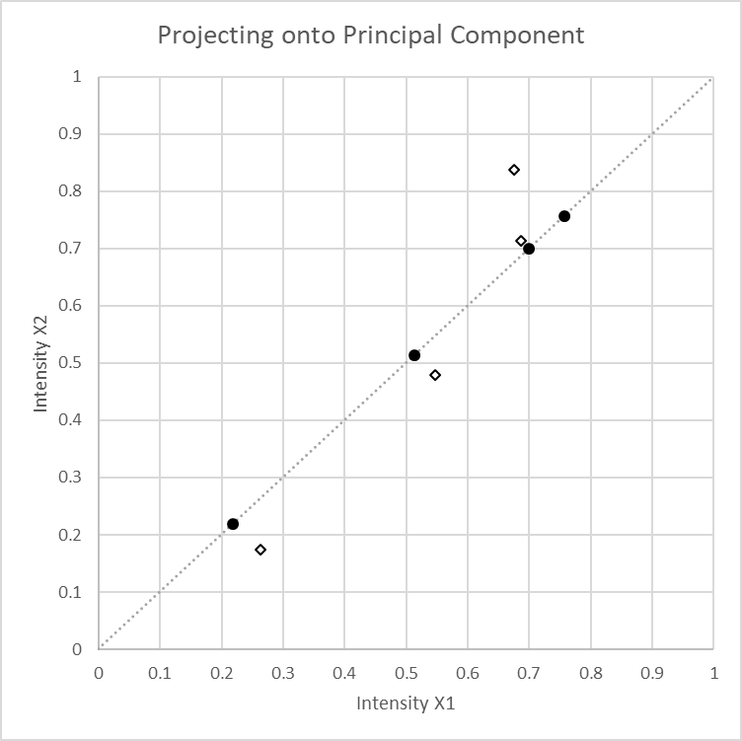
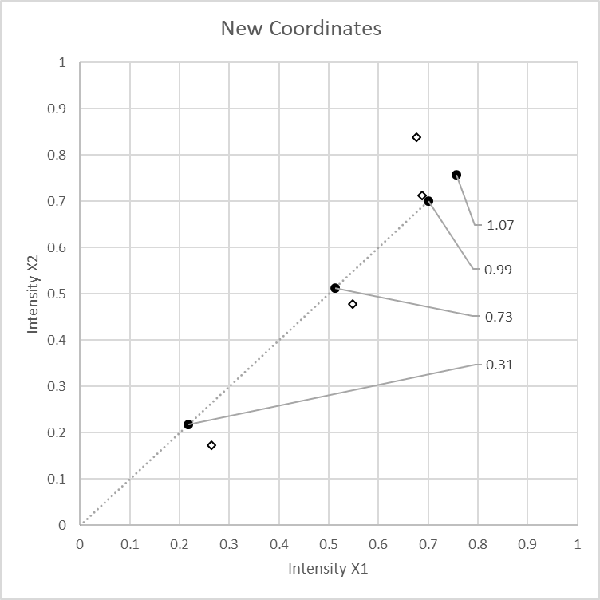
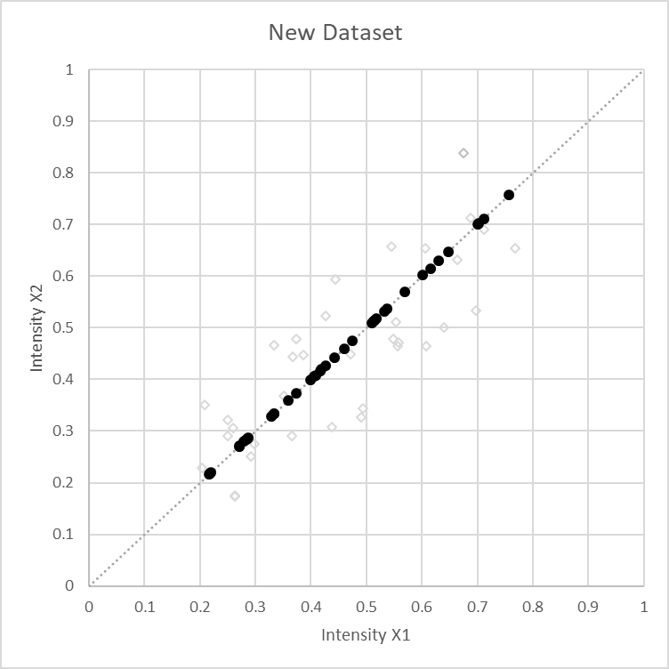
Principal Component Analysis (PCA)
Most explained by:
correlated intensity
Compress data, losing some detail
  2 coordinates -> 1 coordinate
Same process works in N dimensions

Slide 14
Principal Components of our Blink Data
Component 1
Component 2
Component 3
Component 4
Component 5
Component 6
Component 7
Component 8
Component 9
Component 10

Slide 15
Using PCA for Dimensionality Reduction
Using 1
Using 10
Using 50
Using 100
Original (576 dimensions)

Slide 16
Computing PCA (the easy way)
(xTrain, xTest) = BlinkSupport.Featurize(xTrainRaw, xTestRaw, includeGradients=False, includeRawPixels=True)
# >>> len(xTrain[0])
# 576
from sklearn.decomposition import PCA
pca = PCA(n_components=10)
pca.fit(xTrain)
xTrainTransform = pca.transform(xTrain)
# >>> len(xTrainTransform)
# 3634
# >>> len(xTrainTransform[0])
# 10
# to reconstruct from 10 components to original number of dimensions
xTrainRestore = pca.inverse_transform(xTrainTransform)

Slide 17
Summary: Dimensionality Reduction
Map your feature space onto smaller feature space that:
  Captures the core concept of your data
  Drops fine detail
You can often drop many, many dimensions without losing much quality
Algorithms for dimensionality reduction include
  Principal Component Analysis (PCA)
  Embedding (we’ll get to it)

Slide 18
Instance Based Learning
Classification technique that uses data as the model
K-Nearest Neighbors – K-NN
  Model: the training data
  Loss: there isn’t any
  Optimization: there isn’t any
To apply, find the K nearest training data point to the test sample
  Classify: predict the most common label among them
  Probability: predict using the distribution of their labels

Slide 19
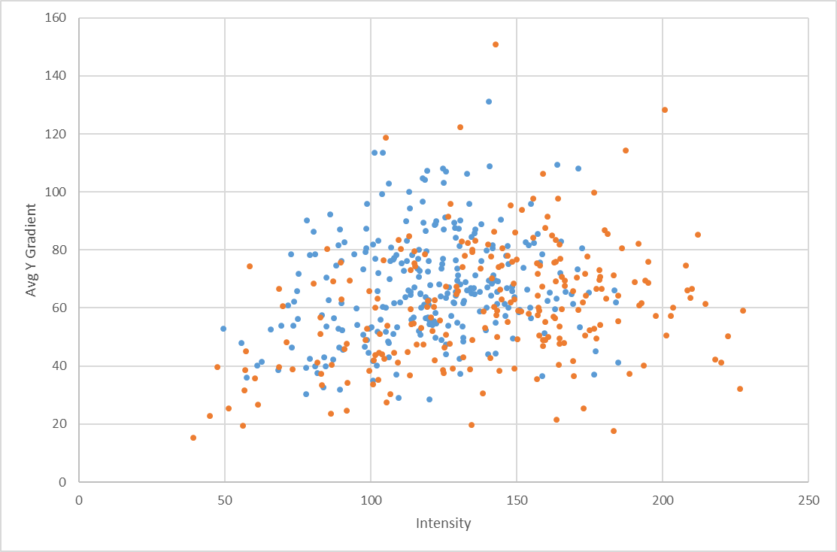
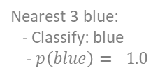
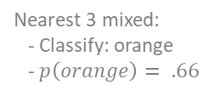
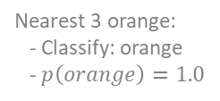
Example of K-NN
Nearest 3 orange:
- Classify: orange
- $p\left(orange\right)=1.0$
Nearest 3 blue:
- Classify: blue
- $p\left(blue\right)= 1.0$
x
Nearest 3 mixed:
- Classify: orange
- $p\left(orange\right)= .66$
x
x

Slide 20
KNN Pseudo Code
def predict(xTest):
# for every sample in training set
# compute the distance to xTest (using l2 norm)
# find the y values of k closest training samples
# return most common y among these values
# or the % that are 1 for a score/probability estimate…
Simple to train
Model can be large
Predict time can be slow

Slide 21
Summary: Instance Based
I think you have the idea…

